Slide 1
Transport Layer
Part I

Slide 2
Transport Layer
Our goals:
Understand principles behind transport layer services:
multiplexing/demultiplexing
reliable data transfer
flow control
congestion control
Services of transport layer are constrained by N/W layer.
Learn about transport layer protocols in the internet:
UDP: connectionless transport
TCP: connection-oriented transport
TCP congestion control
TCP : Segment
UDP: Datagram

Slide 3
Transport Services And Protocols
Provide logical communication between app processes running on different hosts
Transport protocols run in end systems
Sending side: breaks app messages into segments, passes to network layer
Receiving side: reassembles segments into messages, passes to app layer
More than one transport protocol available to apps
Internet: TCP and UDP
application
transport
network
data link
physical
network
data link
physical
network
data link
physical
network
data link
physical
logical end-end transport
network
data link
physical
network
data link
physical
application
transport
network
data link
physical

Slide 4
Transport Vs. Network Layer
network layer: logical communication between hosts
transport layer: logical communication between processes
relies on, enhances, network layer services
IP (Internet Protocol) is a Network Layer protocol
Unreliable
Best Effort Service
No ordering of segments
No guaranteed delivery

Slide 5
Encapsulation

Slide 6
Internet’s Transport-layer Protocols
Reliable, in-order delivery (TCP)
Congestion control
Flow control
Connection setup
Integrity checking
Unreliable, unordered delivery: UDP
Integrity checking
No-frills extension of “best-effort” IP
Services not available:
Delay guarantees
Bandwidth guarantees
application
transport
network
data link
physical
network
data link
physical
network
data link
physical
network
data link
physical
logical end-end transport
network
data link
physical
network
data link
physical
application
transport
network
data link
physical

Slide 7
Ports and Sockets
A port is a predefined internal address that serves as a pathway from the Application to the Transport layer or from the Transport layer to the Application.
A socket is an address formed by concatenating the IP address and the port number.
For instance, the socket number 111.121.131.141.21 refers to port 21 on the computer with the IP address 111.121.131.141

Slide 8
Ports

Slide 9
Sockets

Slide 10
Multiplexing/Demultiplexing
The socket addressing system enables TCP and UDP to perform another important Transport layer task:
multiplexing and demultiplexing

Slide 11
Multiplexing/demultiplexing
Demultiplexing at rcv host:
Multiplexing at send host:
Use header info to deliver
received segments to correct
socket
gathering data from multiple
sockets, enveloping data with
header (later used for
demultiplexing)
= socket
= process
application
application
application
P4
P3
P1
P2
P1
transport
transport
transport
network
network
network
link
link
link
physical
physical
physical
host 1
host 2
host 3

Slide 12
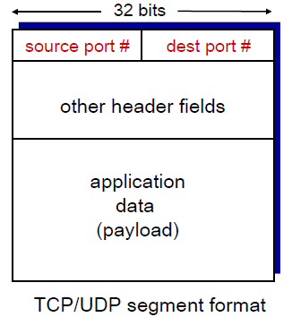
How Demultiplexing Works
Host receives IP datagrams
Each datagram has source IP address, destination IP address
Each datagram carries one transport-layer segment
Each segment has source, destination port number
Host uses IP addresses & port numbers to direct segment to appropriate
Socket

Slide 13
Connectionless demultiplexing
Create sockets with port numbers:
DatagramSocket mySocket1 = new DatagramSocket(12354);
DatagramSocket mySocket2 = new DatagramSocket(12355);
When creating datagram to send into UDP socket, must specify : (Dest IP Address, Dest Port Number)
When host receives UDP segment:
checks destination port number in segment
directs UDP segment to socket with that port number
IP datagrams with different source IP addresses and/or source port numbers directed to same socket

Slide 14
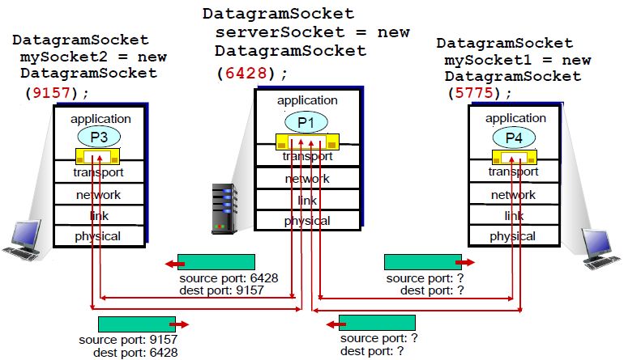
Connectionless demux (cont)
SP provides “return address”

Slide 15
Connection-oriented demux
TCP socket identified by 4-tuple:
source IP address
source port number
dest IP address
dest port number
recv host uses all four values to direct segment to appropriate socket
Server host may support many simultaneous TCP sockets:
each socket identified by its own 4-tuple
Web servers have different sockets for each connecting client
non-persistent HTTP will have different socket for each request

Slide 16
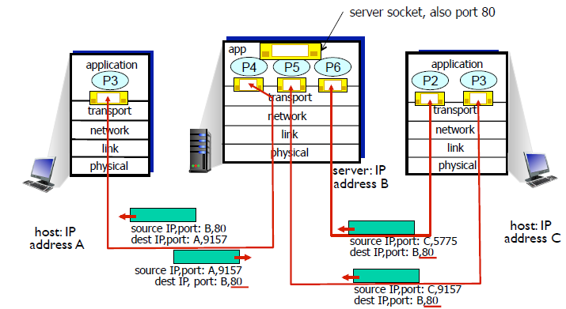
Connection-oriented demux (cont)
three segments, all destined to IP address: B, dest port: 80 are demultiplexed to different sockets

Slide 17
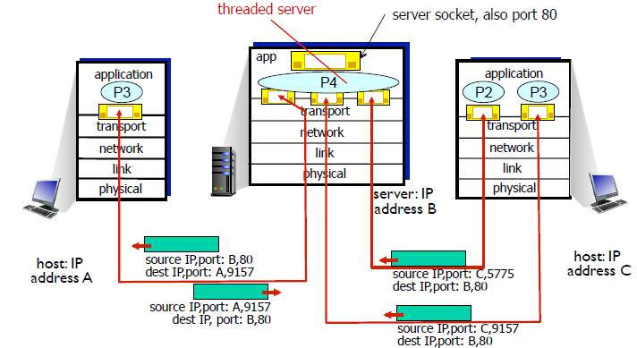
Connection-oriented demux (cont)

Slide 18
UDP
“No Frills,” “Bare Bones” Internet Transport Protocol

Slide 19
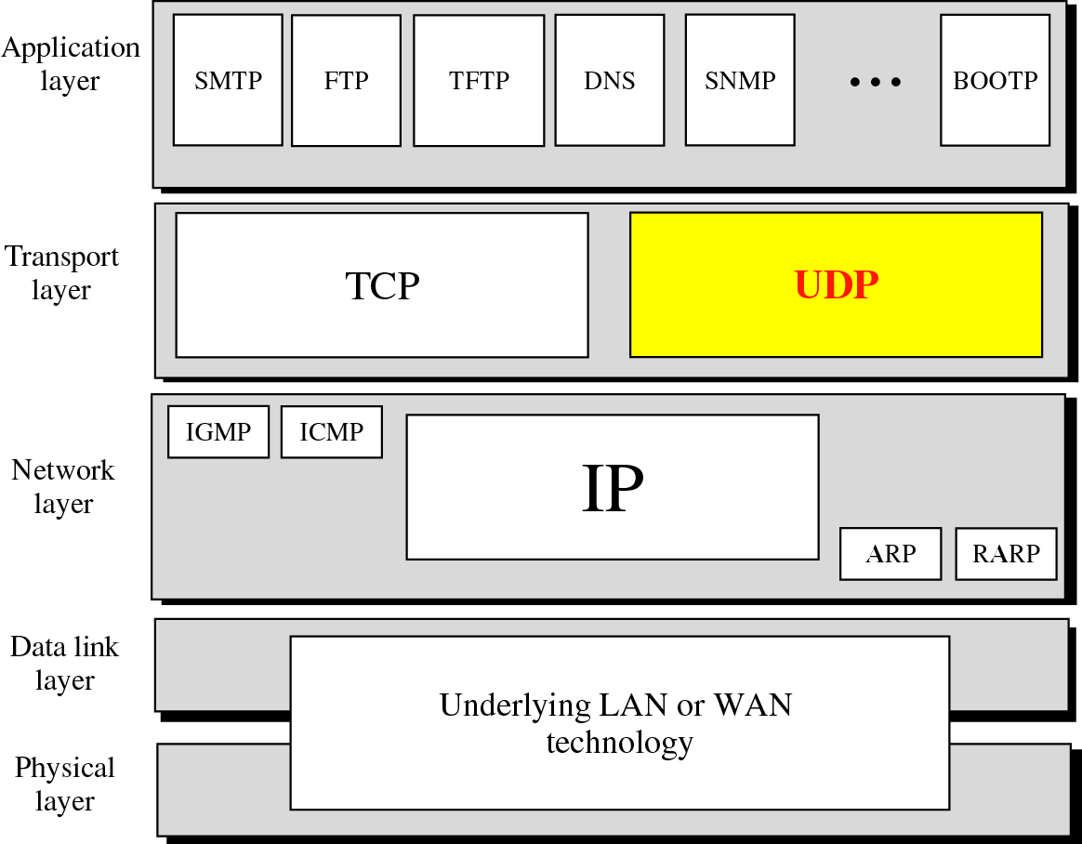
Position of UDP in the TCP/IP protocol suite

Slide 20
UDP
Aside from the multiplexing/demultiplexing function and some light error checking, it adds nothing to IP.
UDP takes messages from application process, attaches source and destination port number fields for the multiplexing/demultiplexing service, adds two other fields of minor importance, and passes the resulting "segment" to the network layer
The network layer encapsulates the segment into an IP datagram and then makes a best-effort attempt to deliver the segment to the receiving host

Slide 21
UDP: User Datagram Protocol [RFC 768]
“Best effort” service, UDP segments may be:
Lost
Delivered out of order to app
Connectionless:
No handshaking between UDP sender, receiver
Each UDP segment handled independently of others

Slide 22
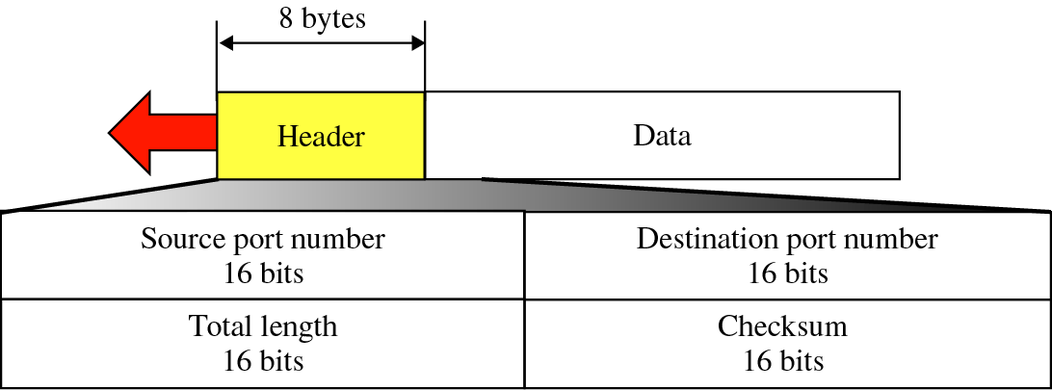
User datagram format
32 bits
Length, in
bytes of UDP
segment,
including
header
source port #
dest port #
length
checksum
Application
data
(message)
UDP segment format

Slide 23
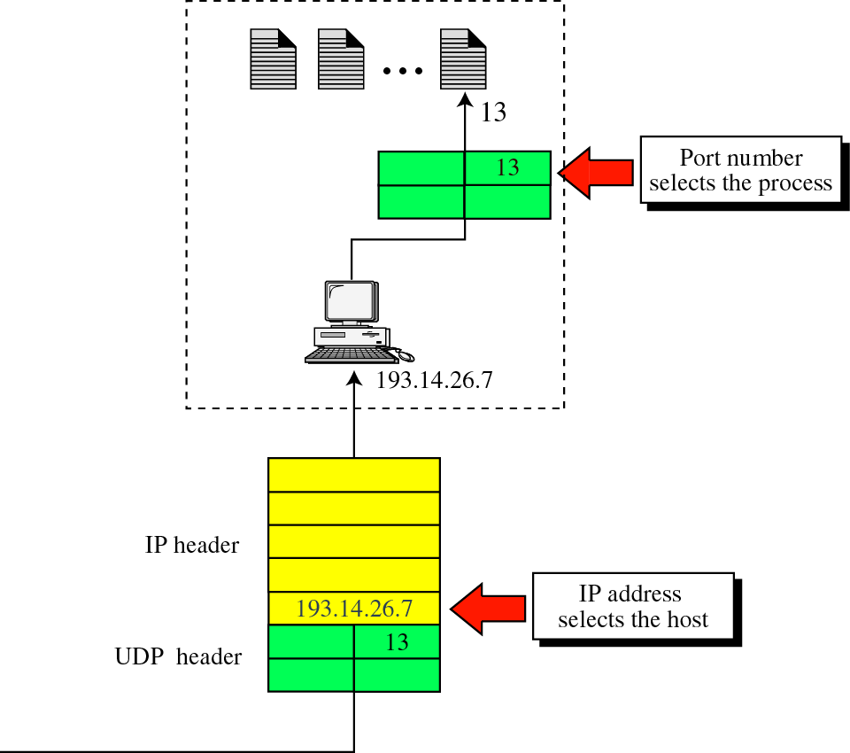
IP addresses versus port numbers

Slide 24
UDP Advantages
No extra processing of data.
No connection establishment (which can add delay)
Simple: no connection state at sender, receiver
Small packet header overhead(20 B Vs 8 B )
No congestion control: UDP can blast away as fast as desired

Slide 25
The following is a dump of a UDP header in hexadecimal format.
a. What is the source port number?
b. What is the destination port number?
c. What is the total length of the user datagram?
d. What is the length of the data?
e. Is the packet directed from a client to a server or vice versa?

Slide 26
Solution
a. The source port number is the first four hexadecimal digits (CB84)₁₆ or 52100.
b. The destination port number is the second four hexadecimal digits (000D)₁₆ or 13.
c. The third four hexadecimal digits (001C)₁₆ define the length of the whole UDP packet as 28 bytes.
d. The length of the data is the length of the whole packet minus the length of the header, or 28 – 8 = 20 bytes.
e. Since the destination port number is 13 (well-known port), the packet is from the client to the server.

Slide 27
Given UDP header in hexadecimal format: 0632 000D 001C E217
i) Source port number? ii) Destination port number? iii) Total length of user datagram? iv) Length of data? What is client process? v) Is the packet directed from a client to server or vice-versa?
Given UDP header in hexadecimal format: 06 32 00 0D 00 1C E2 17
1. The source port number is 0000 0110 0011 0010 that is 1586 in decimal
2. The destination port number is 0000 0000 0000 1101 that is 13
3. The total length of the user datagram is 0000 0000 0001 1100 that is 28bytes
4. The length of the data = 28-8 = 20 bytes. The client process is Daytime because
destination port number(Destination port number represents Daytime process)
5. The packet is directed from a client to a server because destination port number
is 13.

Slide 28
UDP checksum
Goal: detect “errors” (e.g., flipped bits) in transmitted segment
Sender:
treat segment contents as sequence of 16-bit integers
checksum: addition (1’s complement sum) of segment contents
sender puts checksum value into UDP checksum field
Receiver:
compute checksum of received segment
check if computed checksum equals checksum field value:
NO - error detected
YES - no error detected. But maybe errors nonetheless? More later ….

Slide 29
Internet Checksum Example
When adding numbers, a carryout from the most significant bit needs to be added to the result
Example: add two 16-bit integers
1 1 1 1 0 0 1 1 0 0 1 1 0 0 1 1 0
1 1 1 0 1 0 1 0 1 0 1 0 1 0 1 0 1
1 1 0 1 1 1 0 1 1 1 0 1 1 1 0 1 1
+ 1
1 1 0 1 1 1 0 1 1 1 0 1 1 1 1 0 0
1 0 1 0 0 0 1 0 0 0 1 0 0 0 0 1 1
wraparound
sum
checksum
Notes:
Kurose and Ross forgot to say anything about wrapping the carry and adding it to low order bit

Slide 30
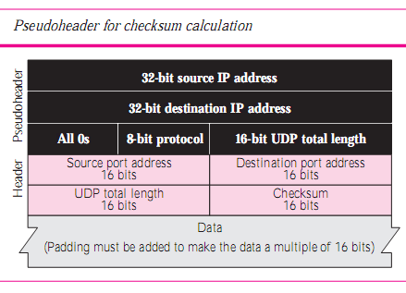

Slide 31
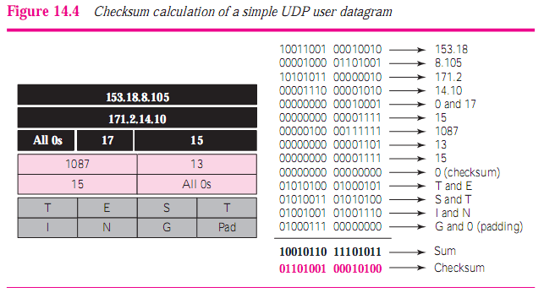
s

Slide 32
Note
The use of the checksum in TCP is mandatory.

Slide 33
TCP
A Connection-oriented and Reliable Stream Delivery Service

Slide 34
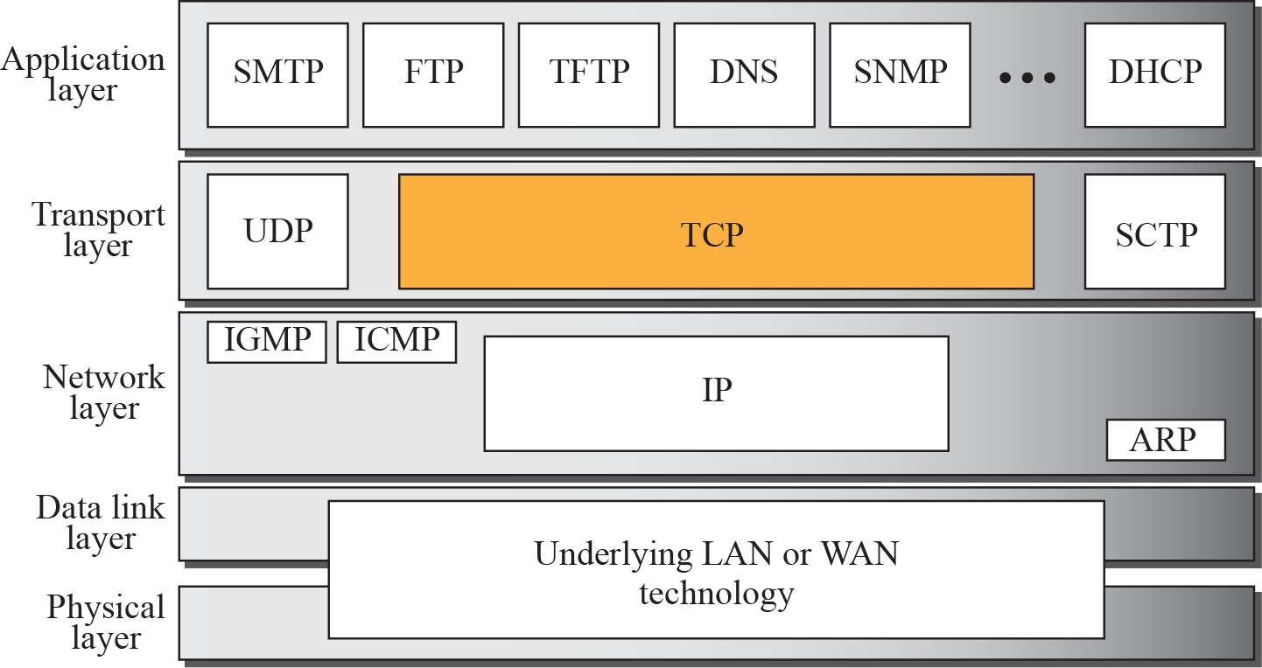
TCP

Slide 35
Ports Used by TCP

Slide 36
Services
Process-to-Process Communication
Stream delivery services
Segments
Full-Duplex
Buffers at sender and receiver
Multiplexing and de-multiplexing
Connection oriented
Reliable in-order byte stream Service

Slide 37
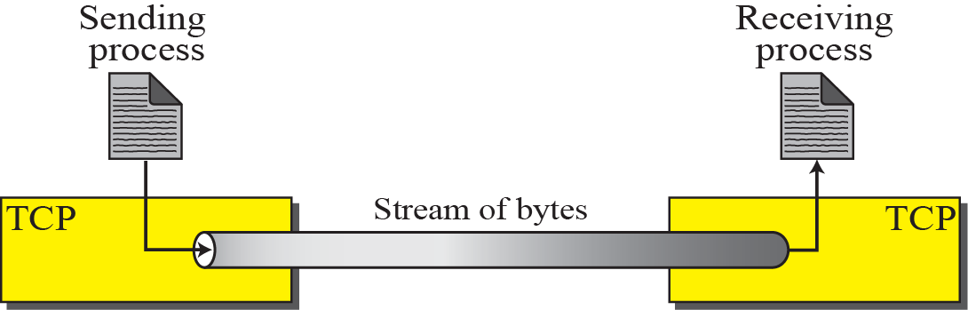
Stream Delivery in TCP

Slide 38
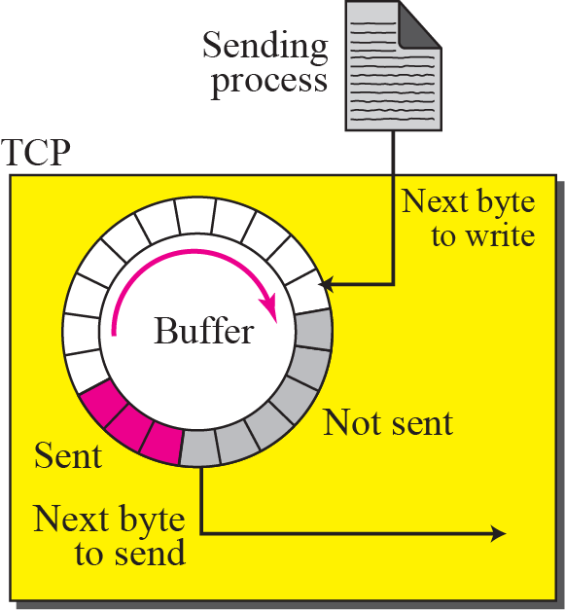
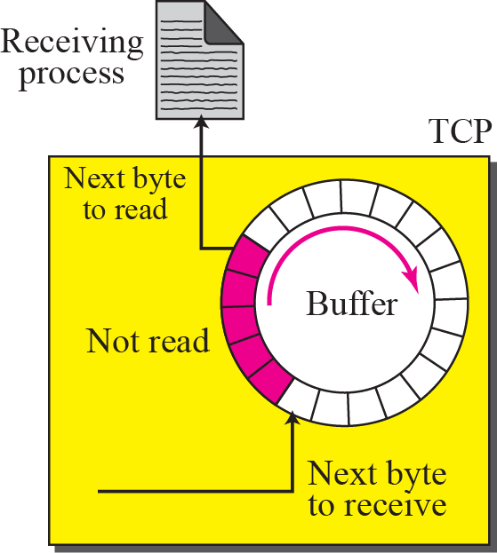
Sending And Receiving Buffers

Slide 39
TCP Segments

Slide 40
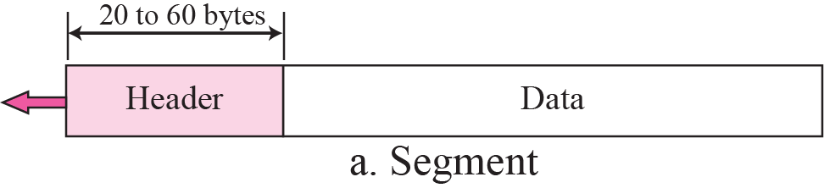
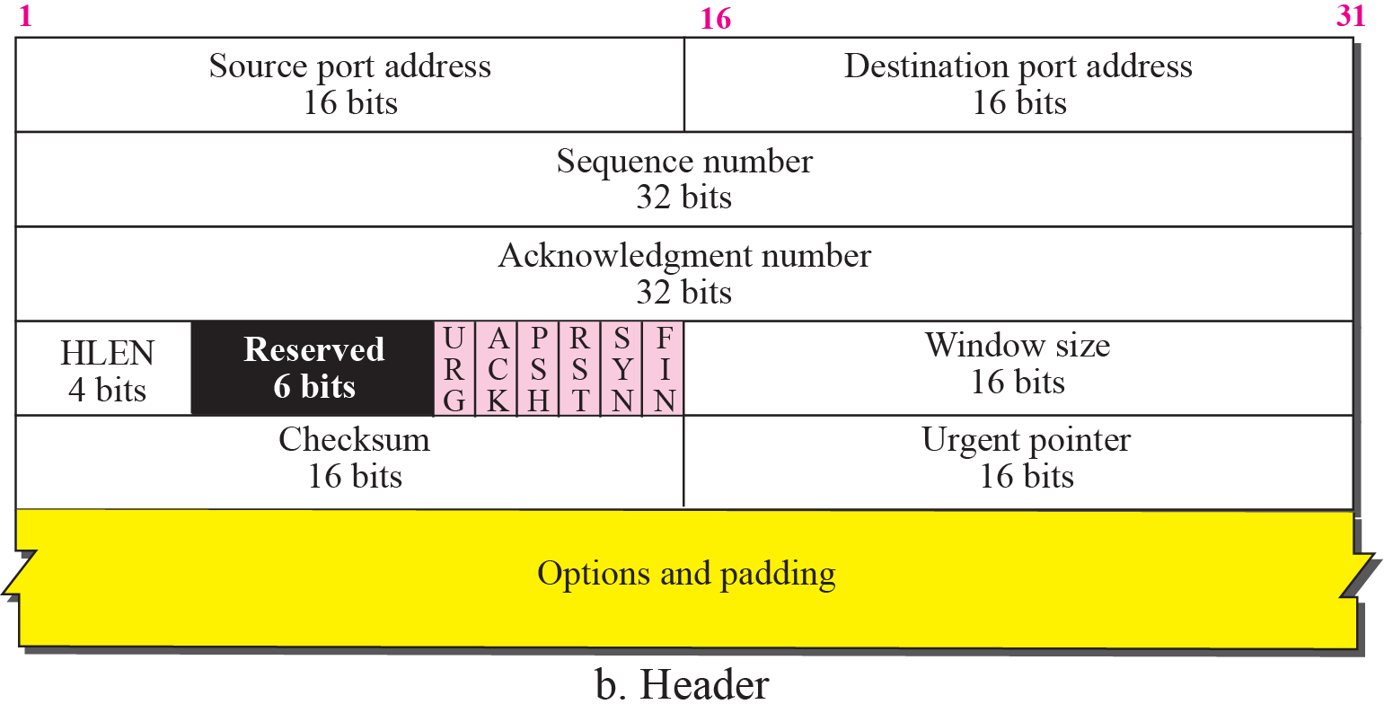
TCP Segments

Slide 41
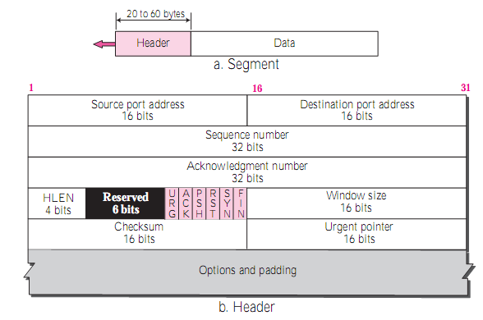
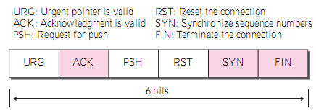

Slide 42
TCP Format
TCP segments have a 20 byte header with >= 0 bytes of data.

Slide 43
TCP header fields
Port Number:
A port number identifies the endpoint of a connection.
A pair <IP address, port number> identifies one endpoint of a connection.
Two pairs <client IP address, client port number> and <server IP address, server port number> identify a TCP connection.

Slide 44
TCP header fields
Sequence Number (SeqNo):
Sequence number is 32 bits long.
So the range of SeqNo is
0 <= SeqNo <= 2³² -1 ≈ 4.3 Gbyte
Each sequence number identifies a byte in the byte stream
Initial Sequence Number (ISN) of a connection is set during connection establishment
Q: What are possible requirements for ISN ?

Slide 45
TCP header fields
Acknowledgement Number (AckNo):
Acknowledgements are piggybacked, I.e
a segment from A -> B can contain an acknowledgement for a data sent in the B -> A direction
A hosts uses the AckNo field to send acknowledgements. (If a host sends an AckNo in a segment it sets the “ACK flag”)
The AckNo contains the next SeqNo that a hosts wants to receive
Example: The acknowledgement for a segment with sequence numbers 0-1500 is AckNo=1501

Slide 46
TCP header fields
Acknowledge Number (cont’d)
TCP uses the sliding window flow protocol to regulate the flow of traffic from sender to receiver
TCP uses the following variation of sliding window:
no NACKs (Negative ACKnowledgement)
only cumulative ACKs
Example:
Assume: Sender sends two segments with “1..1500” and “1501..3000”, but receiver only gets the second segment.
In this case, the receiver cannot acknowledge the second packet. It can only send AckNo=1

Slide 47
TCP header fields
Header Length ( 4bits):
Length of header in 32-bit words
Note that TCP header has variable length (with minimum 20 bytes(5 words) and max 60 bytes(15 Words)

Slide 48
TCP header fields
Flag bits:
URG: Urgent pointer is valid
If the bit is set, the following bytes contain an urgent message in the range:
SeqNo <= urgent message <= SeqNo + urgent pointer
ACK: Acknowledgement Number is valid
PSH: PUSH Flag
Notification from sender to the receiver that the receiver should pass all data that it has to the application.
Normally set by sender when the sender’s buffer is empty

Slide 49
TCP header fields
Flag bits:
RST: Reset the connection
The flag causes the receiver to reset the connection
Receiver of a RST terminates the connection and indicates higher layer application about the reset
SYN: Synchronize sequence numbers
Sent in the first packet when initiating a connection
FIN: Sender is finished with sending
Used for closing a connection
Both sides of a connection must send a FIN

Slide 50
TCP header fields
Window Size:
Each side of the connection advertises the window size
Window size is the maximum number of bytes that a receiver can accept.
Maximum window size is 2¹⁶-1 = 65535 bytes
TCP Checksum:
TCP checksum covers over both TCP header and TCP data (also covers some parts of the IP header)
Urgent Pointer:
Only valid if URG flag is set

Slide 51
TCP header fields
Options Field:

Slide 52
TCP header fields
Options:
NOP is used to pad TCP header to multiples of 4 bytes
Maximum Segment Size
Window Scale Options
Increases the TCP window from 16 to 32 bits, I.e., the window size is interpreted differently
Q: What is the different interpretation ?
This option can only be used in the SYN segment (first segment) during connection establishment time
Timestamp Option
Can be used for roundtrip measurements

Slide 53
Connection in TCP
TCP is connection-oriented => It establishes a virtual path between the source and destination
All of the segments belonging to a message are then sent over this virtual path.
Note:
We may wonder how TCP, which uses the services of IP, a connectionless protocol, can be connection-oriented. The point is that a TCP connection is virtual, not physical. TCP operates at a higher level.
TCP uses the services of IP to deliver individual segments to the receiver, but it controls the connection itself. If a segment is lost or corrupted, it is retransmitted.

Slide 54
Windows In TCP
Before discussing data transfer in TCP and the issues such as flow, error, and congestion control, Lets understand the windows used in TCP
TCP uses 2 windows for each direction of data transfer : Send window and Receive window
This means 4 windows for a bidirectional communication
To make the discussion simple, we make an assumption that communication is only unidirectional; the bidirectional communication can be inferred using two unidirectional communications with piggybacking.

Slide 55
Sequence Numbers
Segments from a sender are numbered sequentially
Since we need to include the sequence no. of each data segment in the header portion for identification => We need to set a limit
If the header of the frame allows ‘m’ bits for sequence no., the numbers range from 0 to 2^{m} -1.
For m = 3: Sequence no. are: 0,1,2,3,4,5,6 and 7

Slide 56
Note
The value in the sequence number field of a segment defines the number assigned to the first data byte contained in that segment.

Slide 57
Example
Suppose a TCP connection is transferring a file of 5,000 bytes. The first byte is numbered 10,001. What are the sequence numbers for each segment if data are sent in five segments, each carrying 1,000 bytes?
Solution
The following shows the sequence number for each segment:

Slide 58
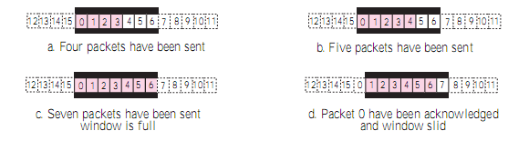
Sliding Window
Let m=4, and
Let Size of window is 7

Slide 59
Flow and Error Control Mechanisms
Stop-and-Wait Protocol
Go-back-N Protocol
Selective Repeat Protocol

Slide 60
Stop-and-Wait Protocol
Sender and receiver use window size of 1
The sender sends one packet at a time and waits for an ack before sending the next one
If pkt lost or corrupted receiver silently discards pkt.
After time-out sender retransmits packet
Stop-and-Wait

Slide 61
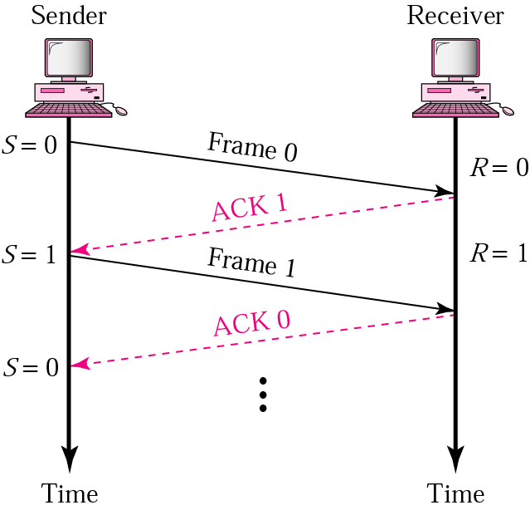

Slide 62
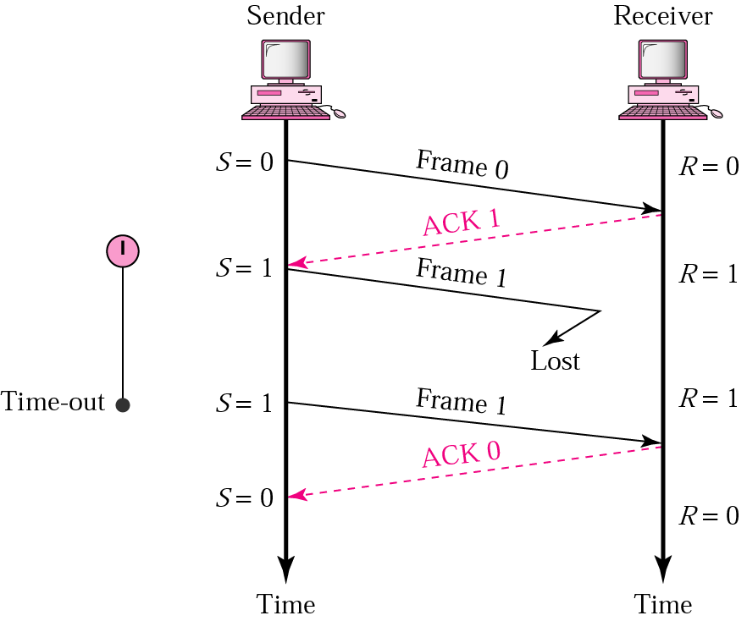
Stop-and-Wait ARQ, damaged frame
When a receiver receives a damaged frame, it discards it and keeps its value of R.
After the timer at the sender expires, another copy of frame 1 is sent.

Slide 63
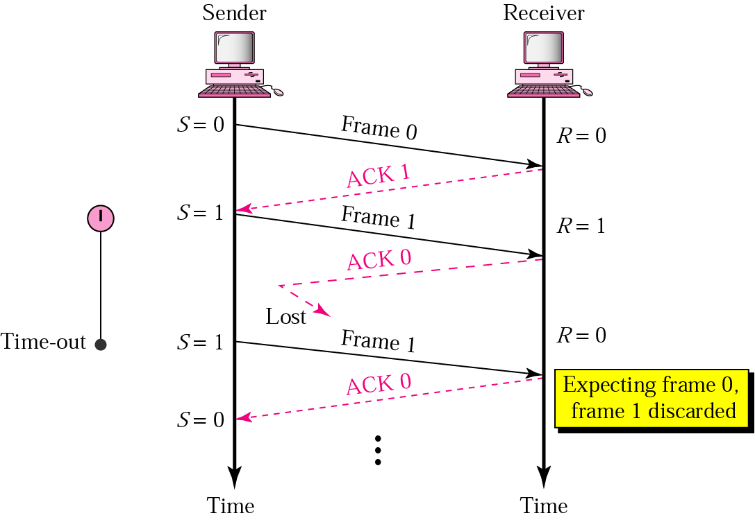
Stop-and-Wait, lost ACK frame
If the sender doesn’t receives an ACK (or damaged ACK), it discards the ACK
When the timer of the sender expires, the sender retransmits frame 1.
Since the Receiver has already received frame 1 and expecting to receive frame 0 (R=0). Therefore it discards the second copy of frame 1.

Slide 64
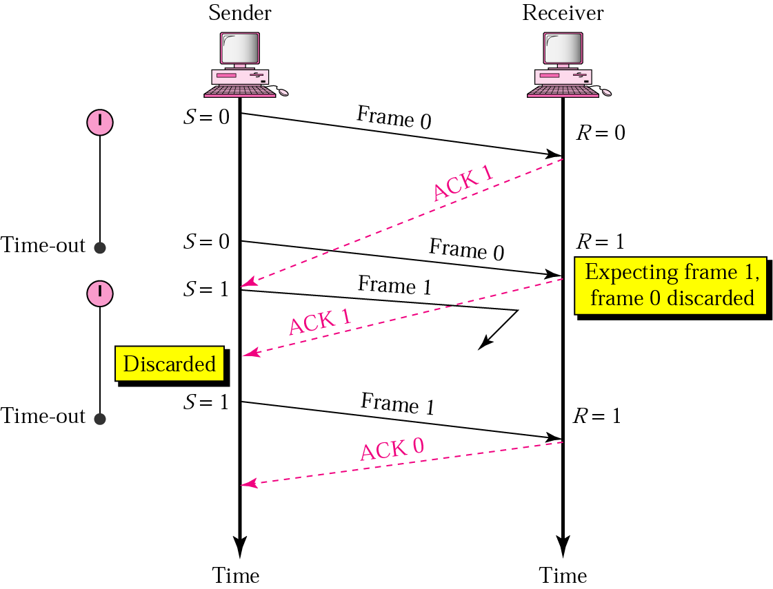
Stop-and-Wait, delayed ACK frame
The ACK can be delayed at the sender’s end due to some problem
It is received after the timer for frame 0 has expired.
Sender retransmitted a copy of frame 0. However, R =1 means receiver expects to see frame 1. Receiver discards the duplicate frame 0.
Sender receives 2 ACKs, it discards the second ACK.

Slide 65
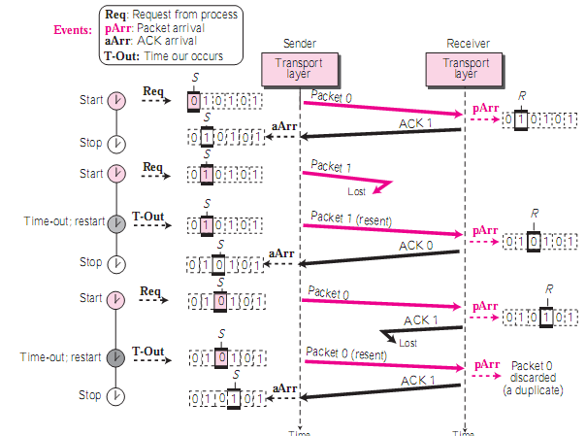

Slide 66
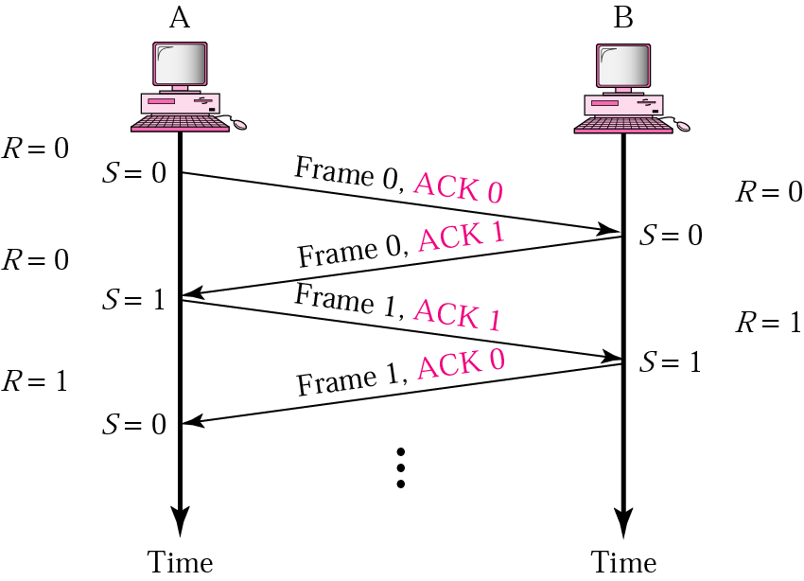
Piggybacking
A method to combine a data frame with ACK.
Station A and B both have data to send.
Instead of sending separately, station A sends a data frame that includes an ACK.
Station B does the same thing.
Piggybacking saves bandwidth.

Slide 67
Stop-and-Wait implements:
Flow Control
by forcing the sender to wait for an ack
Error Control
by discarding corrupted pkts and letting the sender resend unacked packets on timer expires.

Slide 68
Disadvantage of Stop-and-Wait
In stop-and-wait, at any point in time, there is only one frame that is sent and waiting to be acknowledged.
This is not a good use of transmission medium.
To improve efficiency, multiple frames should be in transition while waiting for ACK.
Two protocol use the above concept,
Go-Back-N ARQ
Selective Repeat ARQ

Slide 69
Go-back-N ARQ Protocol
We can send up to W packets before worrying about ACKs.
We keep a copy of these frames until the ACKs arrive.
This procedure requires additional features to be added to Stop-and-Wait ARQ.
Here:
Sequence number
0 to 2^{m}-1, where m represents bits for seq. number
Ack number
is cumulative and defines the sequence number of the next packet expected to arrive

Slide 70
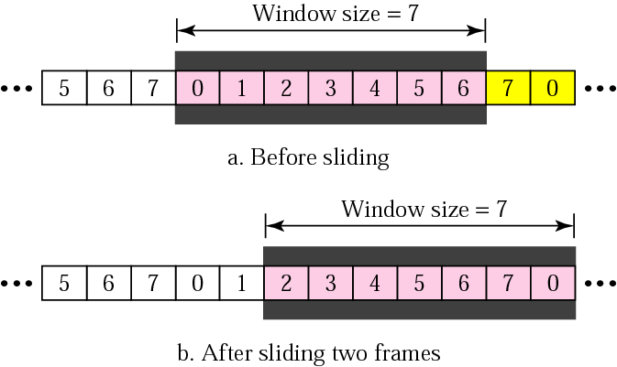
Sender Sliding Window
At the sending site, to hold the outstanding frames until they are acknowledged, we use a window
Size of the window can be variable
Max. size of the window is 2m -1
M = number of bits for the sequence number
The window slides to include new unsent frames when the correct ACKs are received

Slide 71
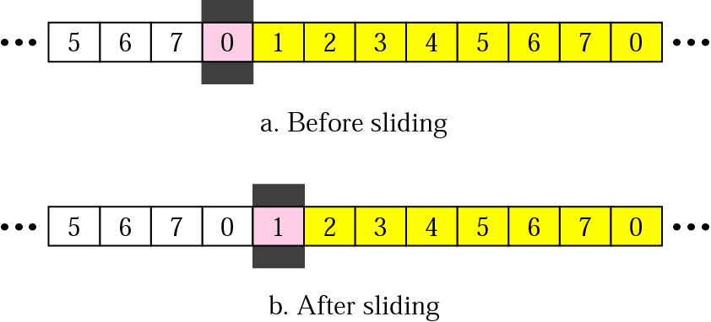
Receiver Sliding Window
Size of the window at the receiving site is always 1 GBN ARQ
Receiver is always looking for a specific frame to arrive in a specific order
Any frame arriving out of order is discarded and needs to be resent
Receiver window slides as shown in fig.
Receiver is waiting for frame 0 in part a in the fig.

Slide 72
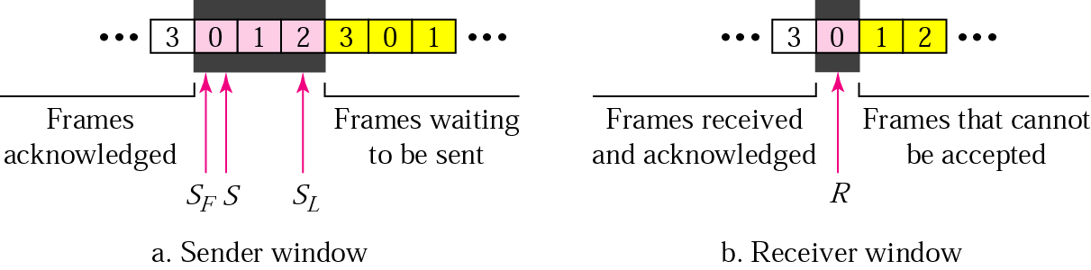
Control Variables
Sender have 3 variables: S, S_{F}, and S_{L}
S holds the sequence number of recently sent frame
S_{F} holds the sequence number of the first frame
S_{L} holds the sequence number of the last frame
Receiver only have only one variable, R, that holds the sequence number of the frame it expects to receive. If the seq. no. is the same as the value of R, the frame is accepted, otherwise rejected

Slide 73
Acknowledgement
Receiver sends positive ACK if a frame arrived safe and in order
If the frames are damaged/out of order, receiver is silent and discard all subsequent frames until it receives the one it is expecting.
The silence of the receiver causes the timer of the unacknowledged frame to expire.
Then the sender resends all frames, beginning with the one with the expired timer.
For example: suppose the sender has sent frame 6, but the timer for frame 3 expires (i.e. frame 3 has not been acknowledged), then the sender goes back and sends frames 3, 4, 5, 6 again. Thus it is called Go-Back-N-ARQ
The receiver does not have to acknowledge each frame received, it can send one cumulative ACK for several frames

Slide 74
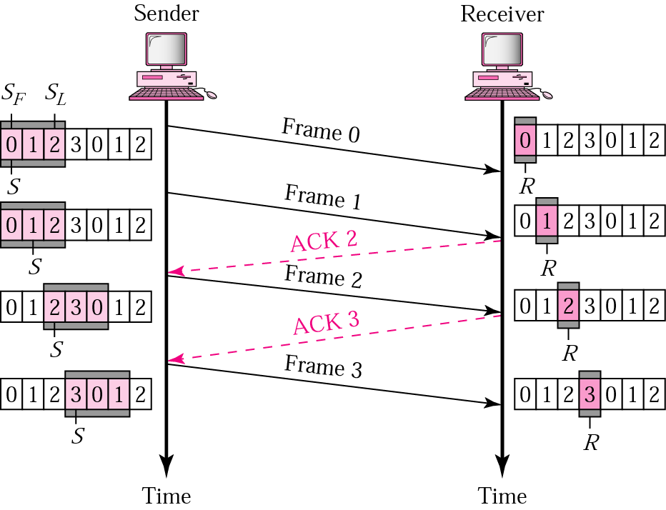
Go-Back-N ARQ, normal operation
The sender keeps track of the outstanding frames and updates the variables and windows as the ACKs arrive.

Slide 75
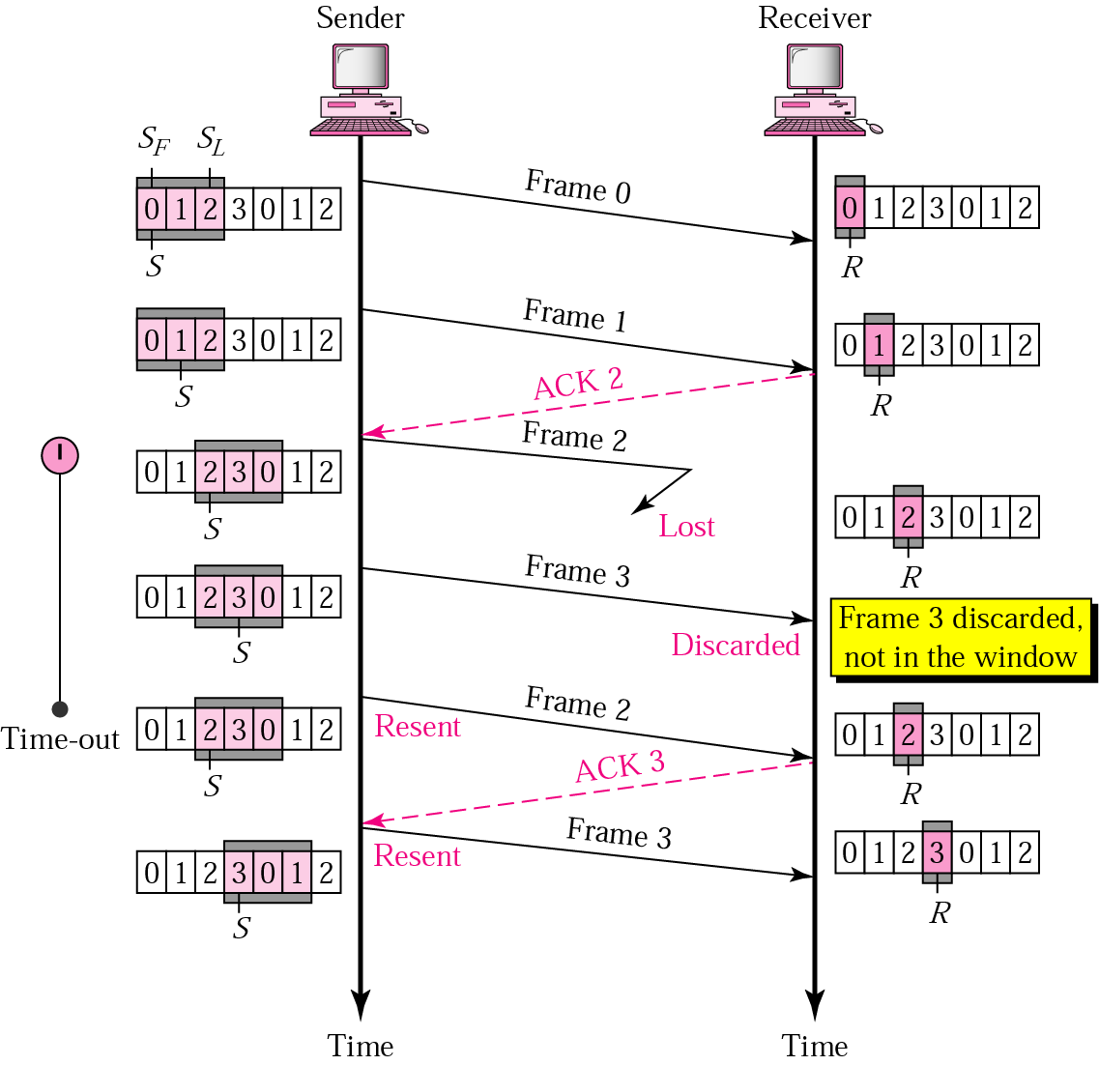
Go-Back-N ARQ, lost frame
Frame 2 is lost
When the receiver receives frame 3, it discards frame 3 as it is expecting frame 2 (according to window).
After the timer for frame 2 expires at the sender site, the sender sends frame 2 and 3. (go back to 2)

Slide 76
Go-Back-N ARQ, damaged/lost/delayed ACK
If an ACK is damaged/lost, we can have two situations:
If the next ACK arrives before the expiration of any timer ➔ there is no need for retransmission of frames because ACKs are cumulative in this protocol.
For Eg. :If ACK1, ACK2, and ACk3 are lost, ACK4 covers them if it arrives before the timer expires.
II. If ACK4 arrives after time-out ➔ the last frame and all the frames after that are resent
Receiver never resends an ACK.
A delayed ACK also triggers the resending of frames

Slide 77
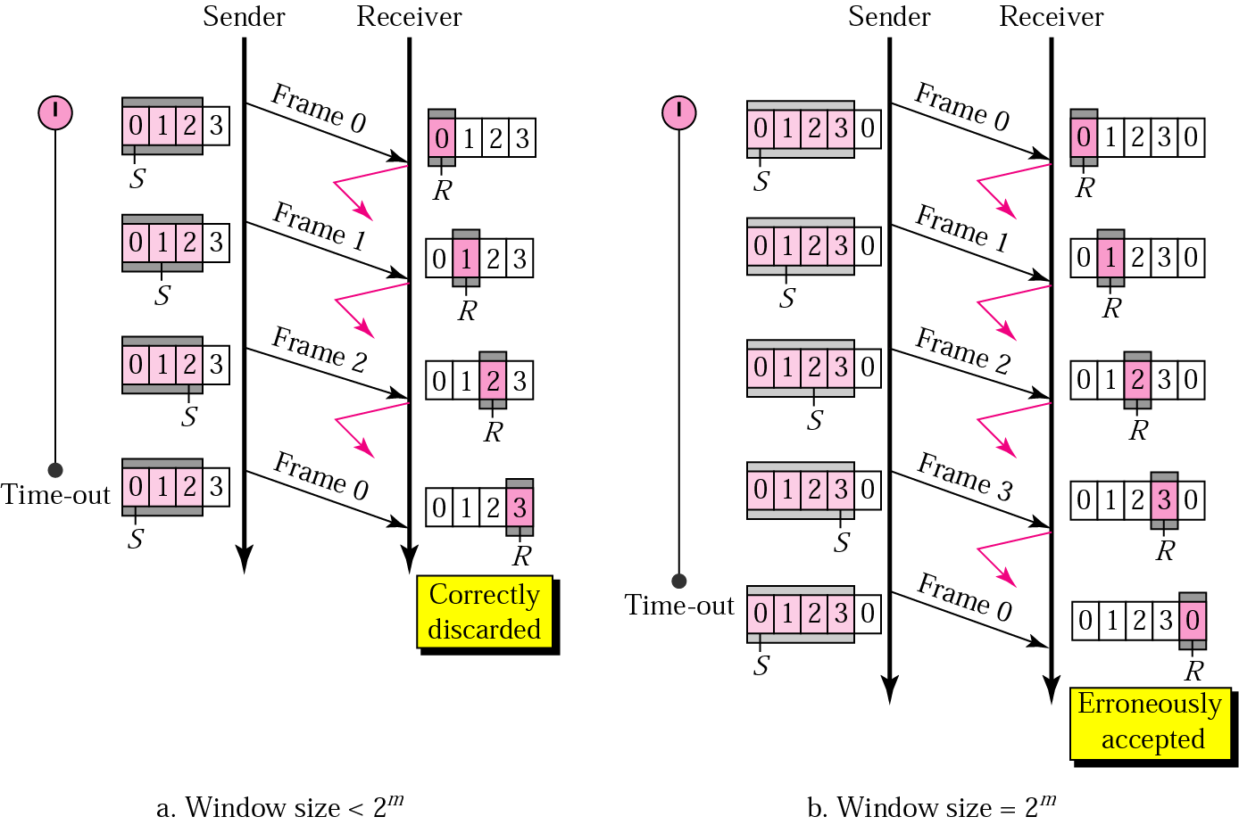
Go-Back-N ARQ, sender window size
Size of the sender window must be less than 2 ^{m}.
Size of the receiver is always 1. If m = 2, window size = 2 ^{m} – 1 = 3.
Fig compares a window size of 3 and 4.
Accepts as the 1st frame in the next cycle-
an error

Slide 78
Example
Draw the sender and receiver windows for a system using Go-back-N ARQ, where a 3 bit field is used and given the following:
Frame 0 is sent; Frame 0 is acknowledged.
Frames 1 and 2 are sent; Frames 1 and 2 are acknowledged.
Frames 3, 4, and 5 are sent; Frames 3 and 4 is acknowledged; Timer for Frame 5 expires.
Frames 5, 6, and 7 are sent; Frames 5 through 7 are acknowledged.

Slide 79
Selective Repeat ARQ
Maximum size of the send as well as receiver window is: 2^{m-1}
For m = 4, the sequence numbers go from 0 to 15, but the maximum size of the window is just 8 (it is 15 in the Go-Back-N Protocol).
GBN ARQ simplifies the process at the receiver site.
Receiver only keeps track of only one variable, and there is no need to buffer out-of-order frames, they are simply discarded.
However, GBN ARQ protocol is inefficient for noisy link. Its bandwidth is inefficient and slows down the transmission.
In Selective Repeat ARQ, only the damaged frame is resent
More bandwidth efficient but more complex processing at receiver.
It defines a negative ACK (NAK) to report the sequence number of a damaged frame before the timer expires.

Slide 80
ACKs
In Selective Repeat, ACKs are sent when data are delivered to the network layer.
If the data belonging to n frames are delivered in one shot, only one ACK is sent for all of them.

Slide 81
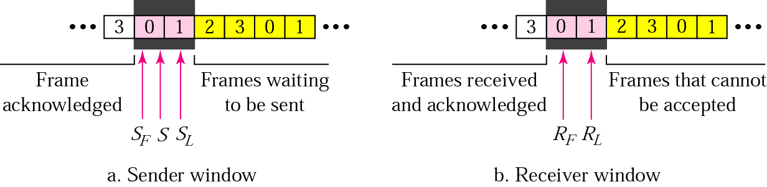
Selective Repeat ARQ
Outstanding packet: waiting for ACK
Timer: separate timer for each outstanding pkt.
Say m=2

Slide 82
NAKs
If we receive a corrupted frame and a NAK has not yet been sent, we send a NAK to tell the other site that we have not received the frame we expected.
The first NAK sent is remembered (using the nakSent variable) and is not sent again until the frame slides.
A NAK is sent once for each window position and defines the first slot in the window.

Slide 83
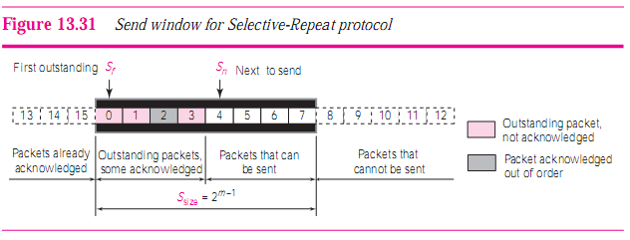
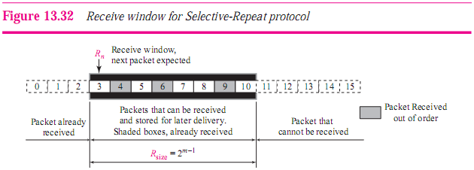

Slide 84
Example
Assume a sender sends 6 packets: packets 0, 1, 2, 3, 4, and 5. The sender receives an ACK with ackNo = 3. What is the interpretation if the system is using GBN or SR?

Slide 85
Answer
If the system is using GBN, it means that packets 0, 1, and 2 have been received uncorrupted and the receiver is expecting packet 3.
If the system is using SR, it means that packet 3 has been received uncorrupted; the ACK does not say anything about other packets.

Slide 86
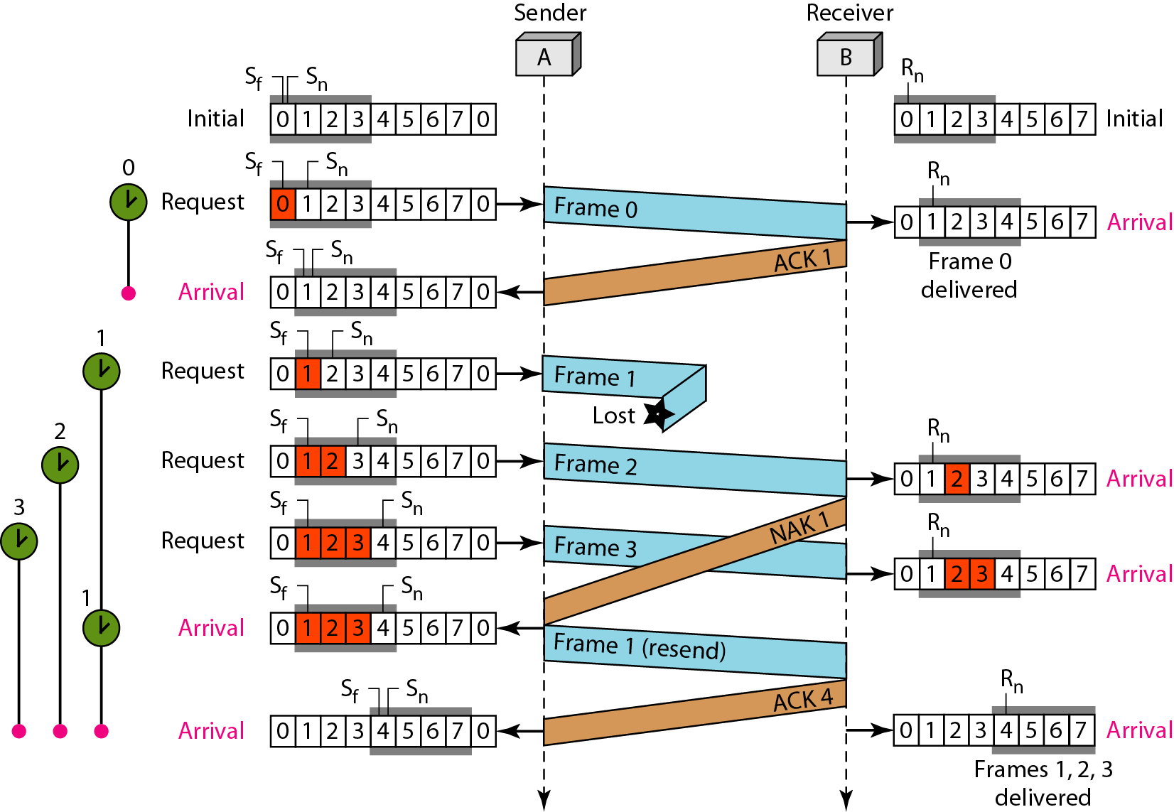
Frames 0, 2 and 3 are accepted when received because they are in the range specified by the rec_window. Even true for frame 4.
Receiver sends a NAK1 to show that frame 1 has not been received and then sender resends only frame 1 and it is accepted as it is in the range of the window.

Slide 87
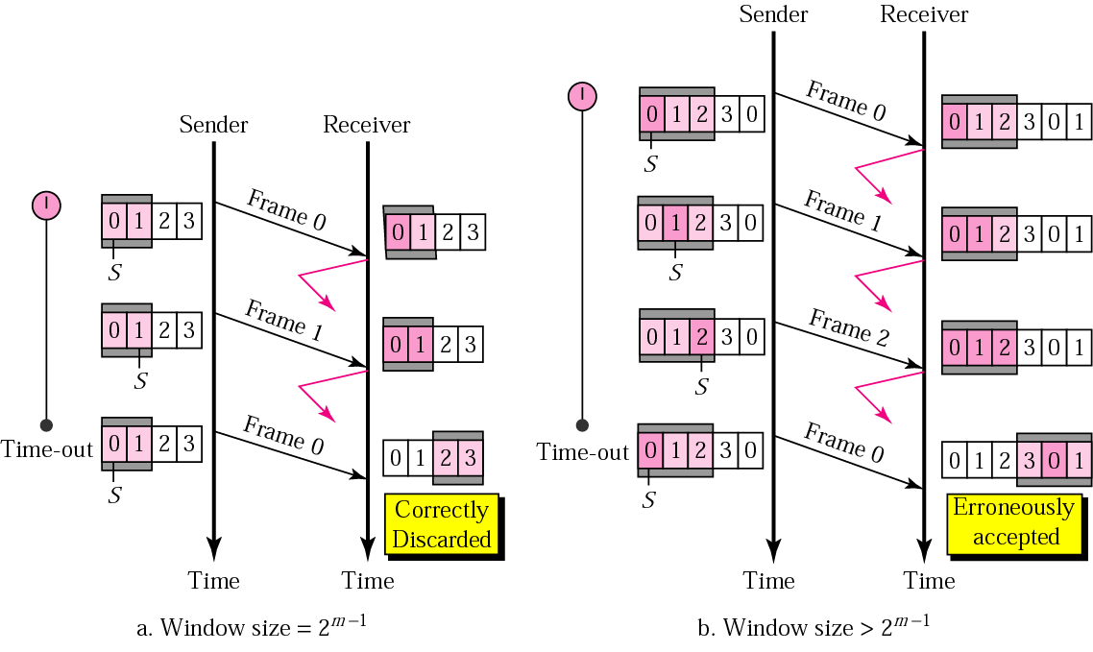
Selective Repeat ARQ, sender window size
Size of the sender and receiver windows must be at most one-half of 2 ^{m}.
Fig compares a window size of 2 with a window size of 3. Window size is 3 and all ACKs are lost, sender sends duplicate of frame 0, window of the receiver expect to receive frame 0 (part of the window), so accepts frame 0, as the 1st frame of the next cycle – an error.

Slide 88
True OR False?
With the SR protocol, it is possible for the sender to receive an ACK for a packet that falls outside of its current window.
With GBN , it is possible for the sender to receive an ACK for a packet that falls outside of its current window.

